Slide 1
Interaction Studio
Ganesh

Slide 2
Interaction studio basics
Reports
Web campaign: Info Bar, Email Popup, A/B testing, Rule based, Rule testing, Product or web recommendation.
Email campaign: Email item template, Open-time template
Mobile campaign: In app message, Push notification
Catalog: Products, Categories, Promotion, Colures, Features, Genders
Einstein Recipes: Ingredients, Filters, Boosters, variations

Slide 3
Interaction Studio
Integrate website to interaction studio
Artificial Intelligence, Machine learning capture the user’s behavior.
Provide real time recommendations
Based on user experience it’s recommend web campaign, email campaign, mobile campaign.
1-to-1 recommendations.
Display Next Best Action(NBA) Offers.
Real time online to offline assistance.
Site Mapping
Web Campaign
Email Campaign
Mobile Campaign

Slide 4
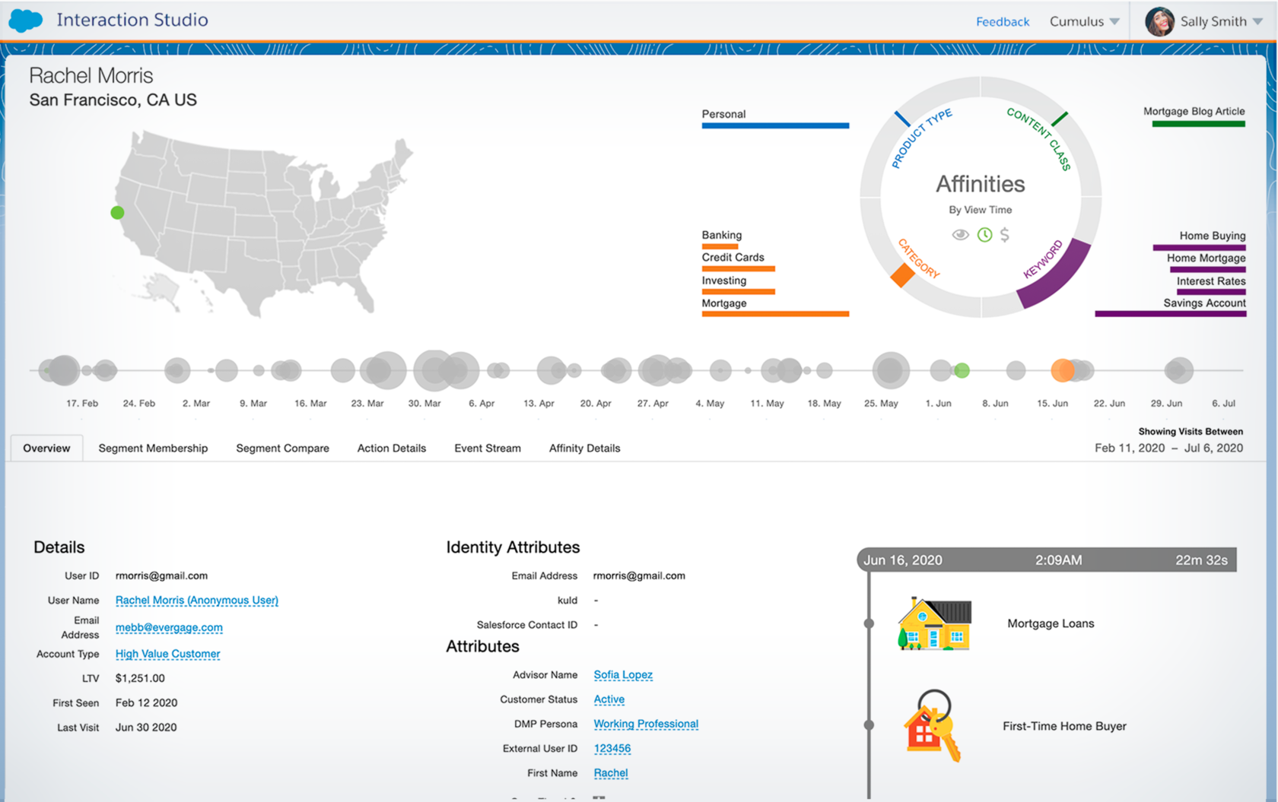
Reports
Reports regarding the User Behavior.
Email, username, first seen, first visit, last visit, time spent on products/brands, orders: total order, max order, avg order, time stamp, device type.

Slide 5
Channels and Communication
Web Campaign:
Site personalized for a visitor based on behavior, affinities, preference, location .
Home page Hero: Experience 1, Experience 2, Default.
Info Bar: Banner header displaying the offer discount like…25%/50%/70%.
Email popup: Capture the user mail id and recommend the email templates.
A/B testing: Testing banner which is performing best performance.
Rule based: Based on condition rules
Email Campaign:
Marketing Cloud Personalization's Open Time Email (OTE) Campaigns and Item Templates enable you to deliver content and product recommendations personalized at the time a recipient opens an email.
Open time email template is a combination of image, name, brand, price, call to action into single template.
A block of email HTML code that can be placed directly into a greater html template to create a personalized experience in any emails.
Experience is promotions and Actions.
Dynamic emails based on content zones.

Slide 6
Mobile Campaign:
In app message : In-app messages allow you to interact with your mobile app users while they use your mobile app, which is when they are most engaged. Trigger a message to show in your mobile app when a user opens the app on their device.
Push Notification: Manage segmented audiences of mobile contacts. Send targeted and personalized push notifications. Use geofence and beacon messaging for location-based campaigns

Slide 7
Machine Learning
Einstein Recipes :
• Ingredients: Ingredients are the core algorithms driving an Einstein Recipe. Select from a list of ingredients to return the most effective recommendations for your visitors.
• Filters: Exclusions and Inclusions
• Boosters: Boosters use a visitor's affinity score to match that affinity and boost it in the recommendations query results.
Variations: Variations are used to modify the returned results to provide more options to the user.

Slide 8
